Slide 1
Research support system
Preety Bhogal

Slide 2
PROBLEM STATEMENT
To build Research Paper Recommender System for users to provide relevant suggestions of working papers in economics, similar in characteristics to the queried working paper.

Slide 3
INTRODUCTION
Massive information available on the internet
Need to sort and provide only relevant information
Recommender System – filters the most similar information to the search query, thus enhancing the user-experience
Users (students, academicians, research organizations, universities) will have an easy access to relevant information

Slide 4
DATA OVERVIEW
Data on research papers published by the National Bureau of Economic Research (NBER)
Dataset comprises of –
Title of the paper
Author Information
Paper code
Year and month in which the paper is published (1975-2015)
Program Group for the paper (Law, Labor, Aging – 21 programs)
Over 20,000 research papers published during this time period, by about 10,000 authors

Slide 5
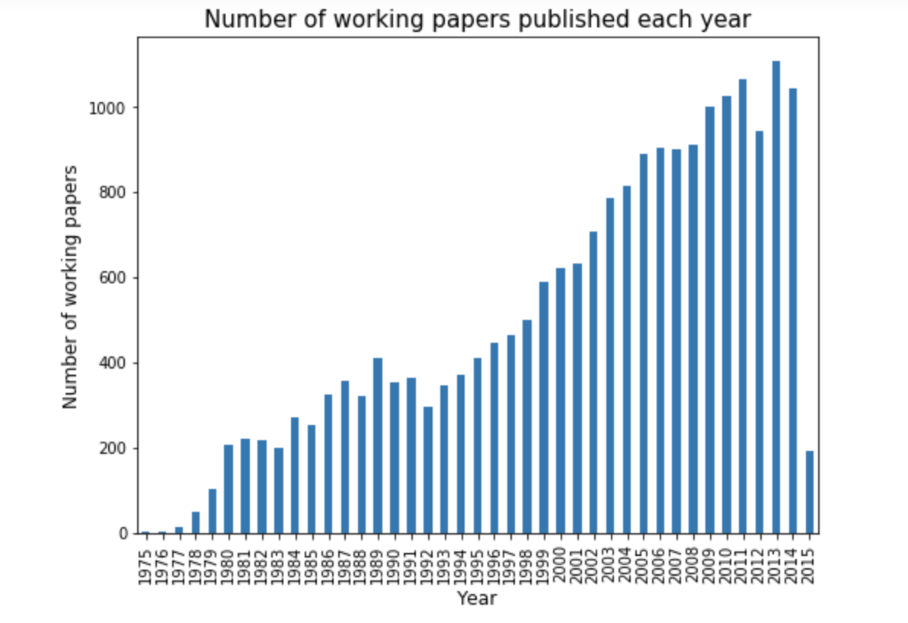
KEY DATA TRENDS

Slide 6
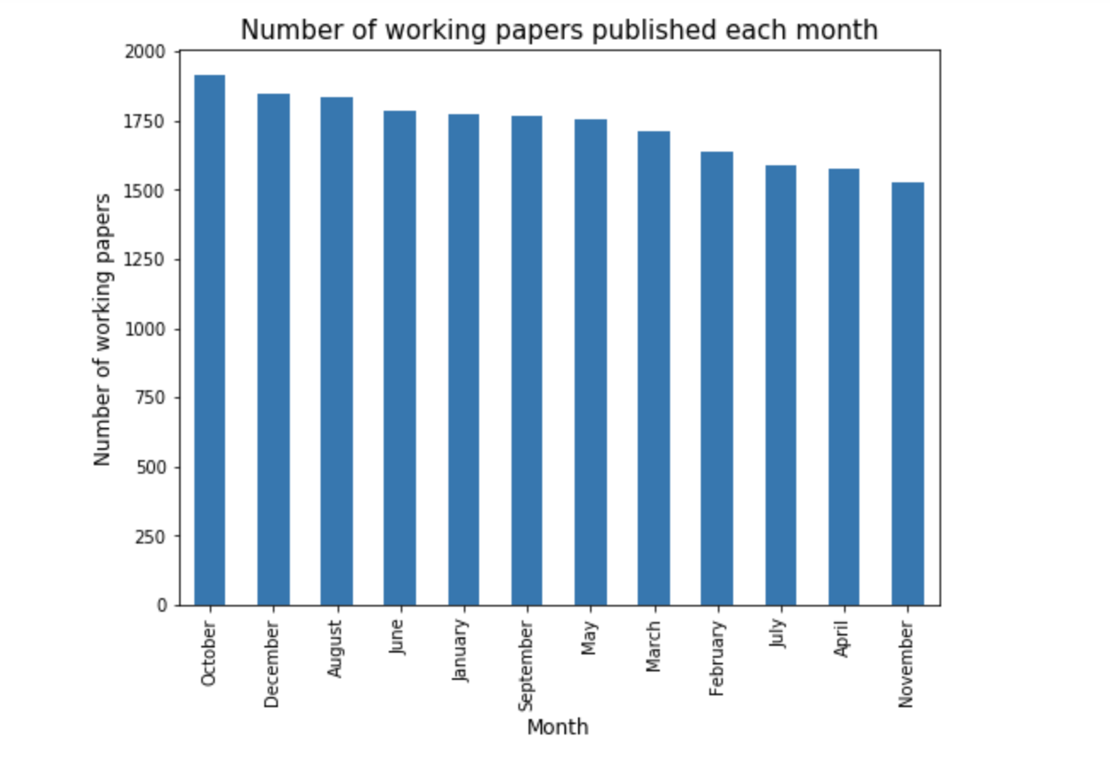
KEY DATA TRENDS

Slide 7
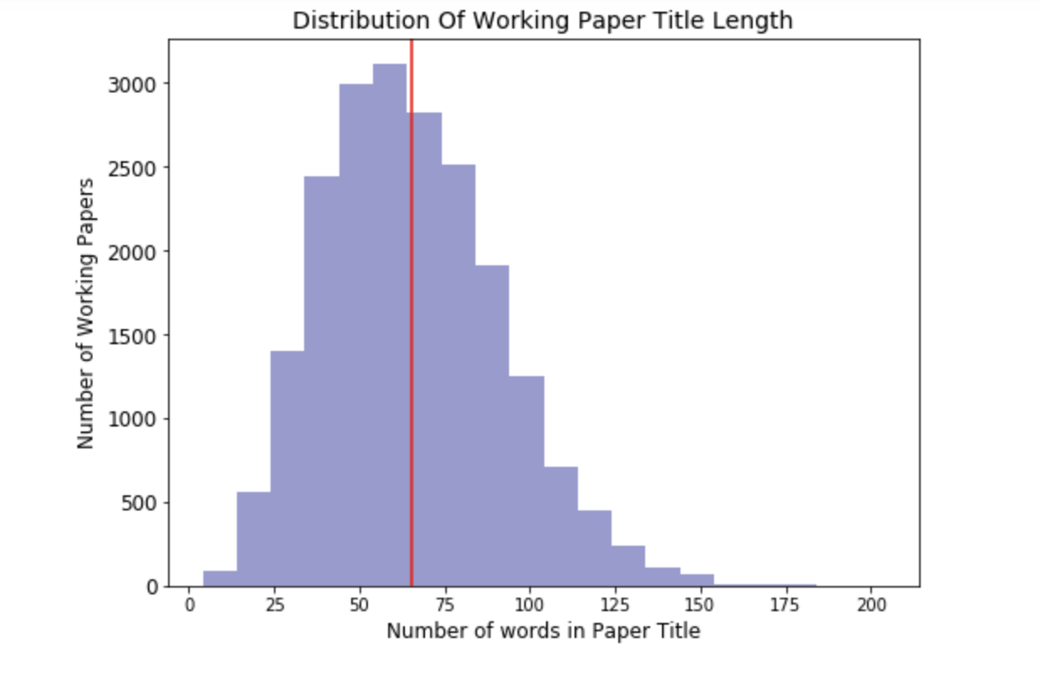
KEY DATA TRENDS

Slide 8

KEY DATA TRENDS

Slide 9
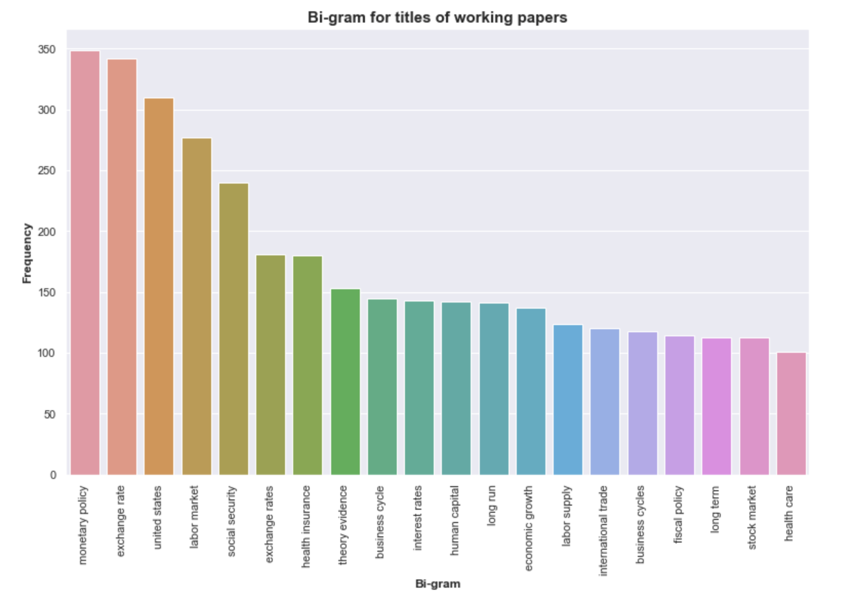
KEY DATA TRENDS

Slide 10
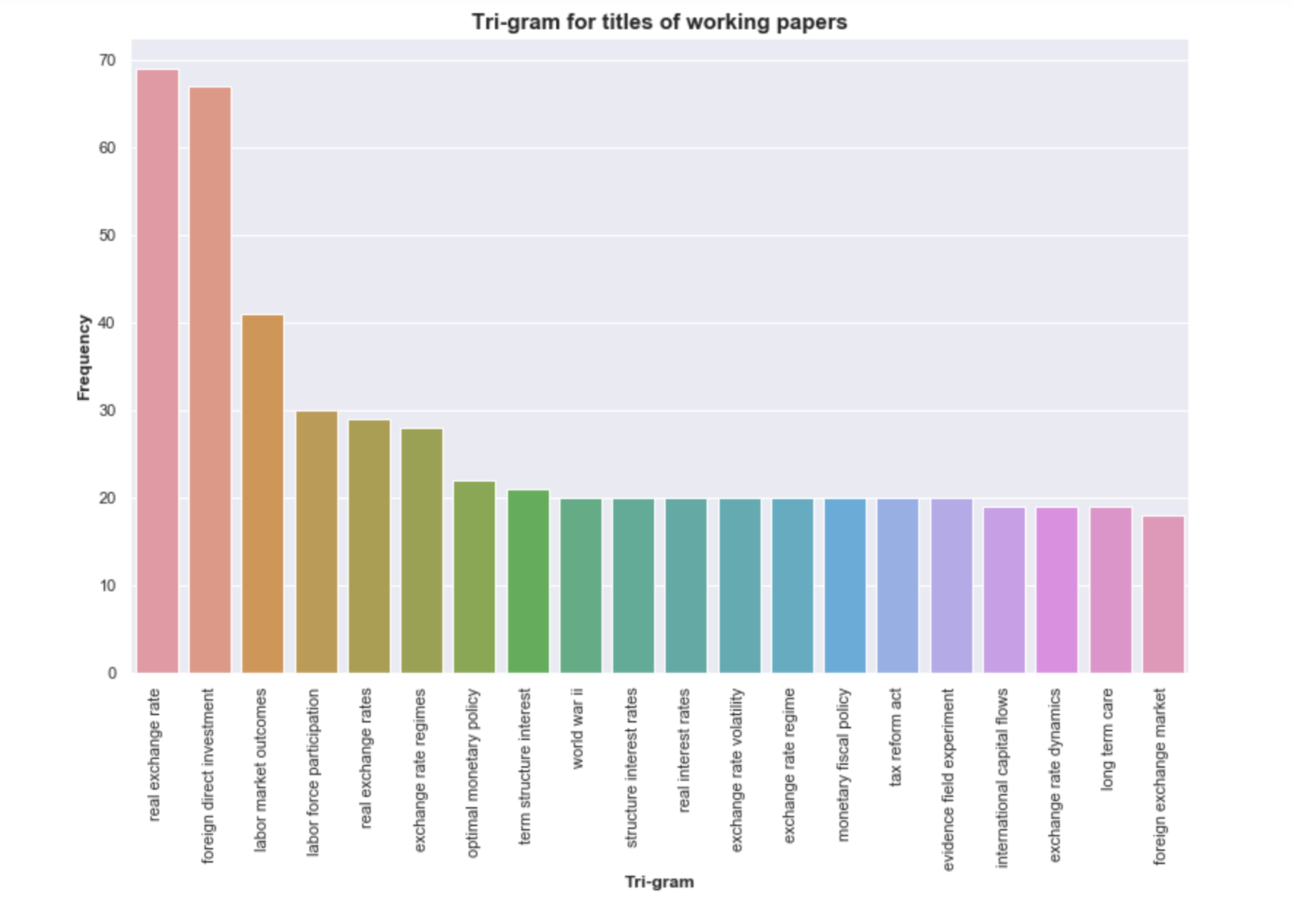
KEY DATA TRENDS

Slide 11
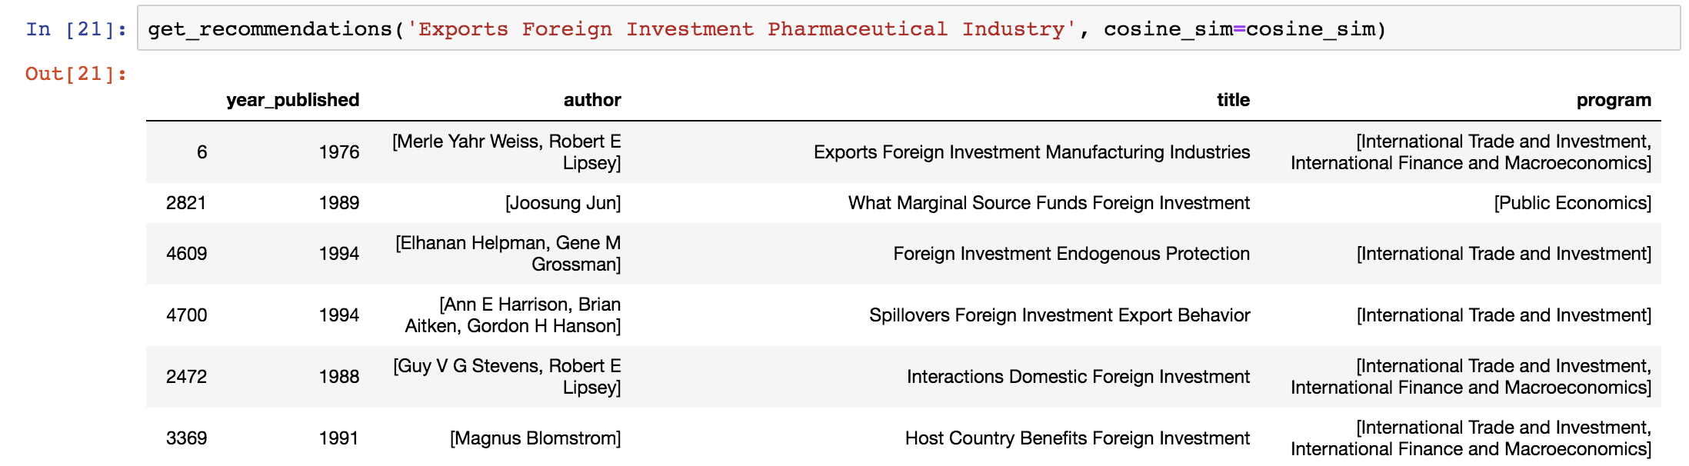
RECOMMENDER SYSTEM (TITLE ONLY)
Search Query: “Exports Foreign Investment Pharmaceutical Industry”
Authors: Merle Yahr Weiss, Robert E Lipsey (1975)
Program: International Trade and Investment, International Finance and Macroeconomics

Slide 12
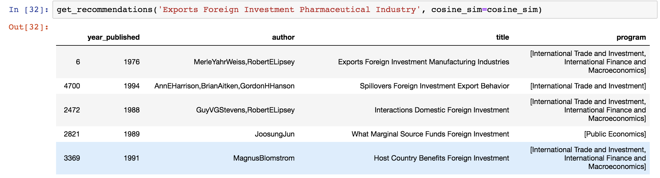
RECOMMENDER SYSTEM (TITLE & AUTHOR)
Search Query: “Exports Foreign Investment Pharmaceutical Industry”
Authors: Merle Yahr Weiss, Robert E Lipsey (1975)
Program: International Trade and Investment, International Finance and Macroeconomics

Slide 13
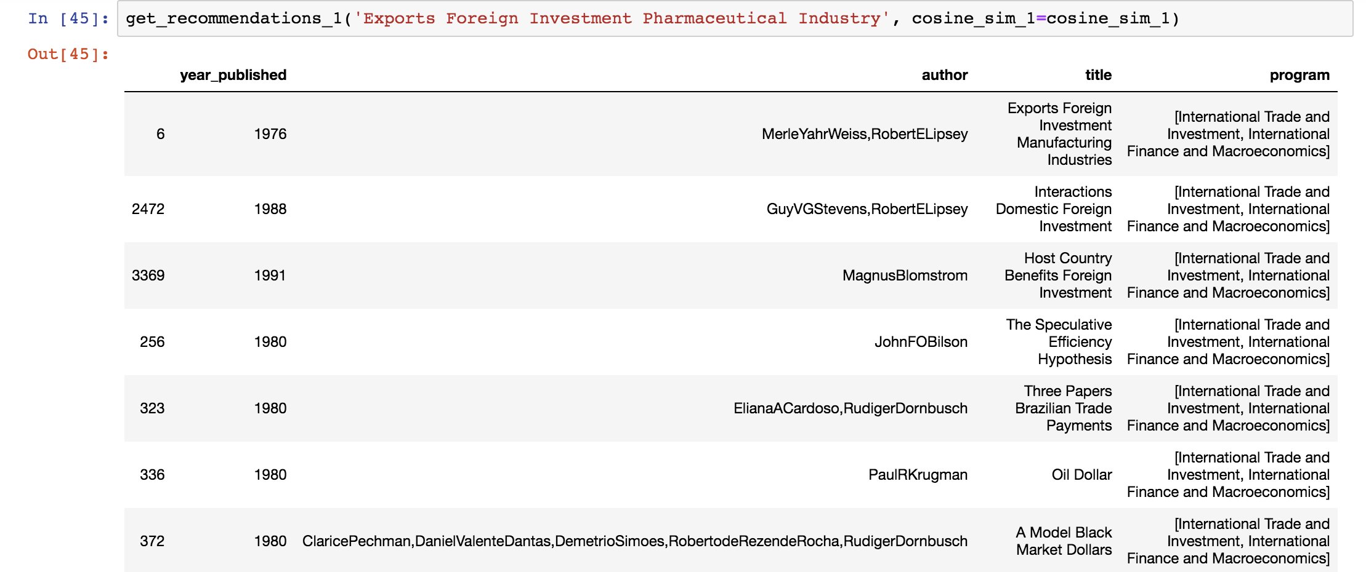
RECOMMENDER SYSTEM (TITLE, AUTHOR & PROGRAM)
Search Query: “Exports Foreign Investment Pharmaceutical Industry”
Authors: Merle Yahr Weiss, Robert E Lipsey (1975)
Program: International Trade and Investment, International Finance and Macroeconomics

Slide 14
CONCLUSIONS
The first recommender system (with only title) - the most similar titles across different programs.
The second recommender system (with title and author) - the most similar titles and authors. It is putting some weight to the authors as well.
The third recommender system (with title, author and program) - the most similar paper in the entire corpus. Similar title, similar author, and similar programs. Mostly recommending papers in the same program first, followed by papers in different programs. Priority is on the same program.
Notes:
The three models are recommending almost similar research papers.

Slide 15
LIMITATIONS
The recommender system is based only on texts of titles, no information about user preferences is included. If this information is available (in terms of no. of times a paper is cited/downloaded), a more robust model could be built.
This current recommender system is limited only to the working papers published by the NBER. It can be extended to other fields of science and social sciences.

Slide 16
ADDITIONAL APPLICATIONS
Since a recommender system streamlines the research conducted by researchers or entities, it acts as a research support system. It can be deployed in universities, libraries, knowledge process outsourcing companies, etc.
The recommender system can be expanded to include more fields of research such as science, mathematics, among others to cater to the needs of a larger audience.

